Slide 1
Fluid Mechanics
Mtro. Victor Rubio

Slide 2
Content
Unit I
Introduction
Fundamental Concepts
Fluid Statics
Unit II
Integral Relations for a control volume
Unit III
Differential relations for a fluid flow
Dimensional Analysis and similitude
Unit IV
Internal Incompressible Viscous Flow

Slide 3
UNIT I
Chapter 1 Introduction
Definition of a fluid
Basic Equations
Methods of Analysis
Chapter 2 Fundamental Concepts
Fluid as a Continuum
No-Slip Condition
Velocity Field
Stress Field
Viscosity
Description and classification of Fluid motion
Thermodynamic properties of a fluid
Flow visualization techniques and brief history of Fluid Mechanics

Slide 4
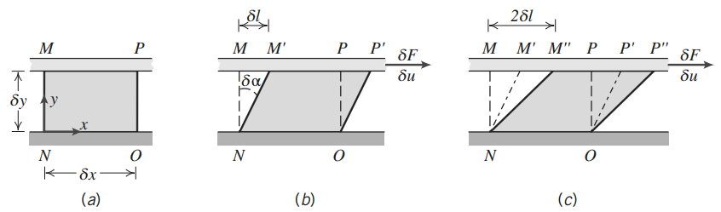
Chapter 2 – fundamental concepts
Viscosity
Solids are elastic: stresses developed when the material is elastically deformed.
Fluids are viscous: shear stresses arise due to viscous flow.

Slide 5
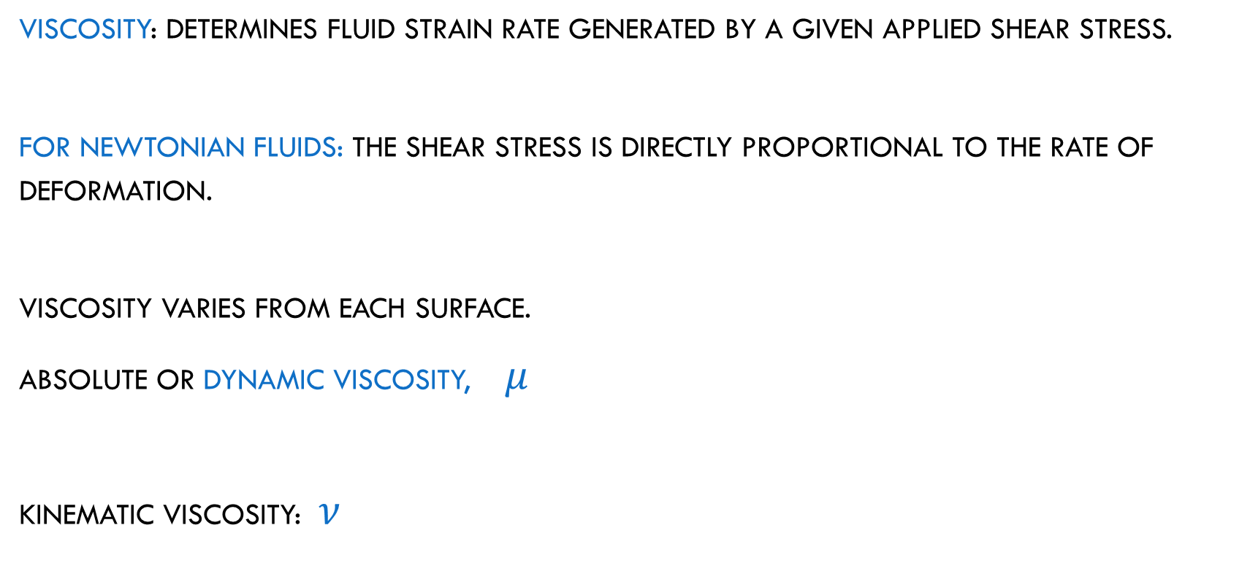
Chapter 2 – fundamental concepts
Viscosity
Viscosity: determines fluid strain rate generated by a given applied shear stress.
For Newtonian Fluids: The shear stress is directly proportional to the rate of deformation.
Viscosity varies from each surface.
Absolute or dynamic viscosity, $μ$
Kinematic viscosity: $ν$

Slide 6
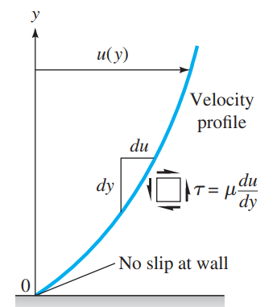
Chapter 2 – fundamental concepts
Viscosity
Strain angle is not often required, but is the velocity distribution instead.

Slide 7
Chapter 2 – fundamental concepts
Viscosity is a True thermodynamic property and varies with temperature and pressure
For gasses: viscosity increases when temperature increases
For liquids: viscosity decreases when temperature increase

Slide 8
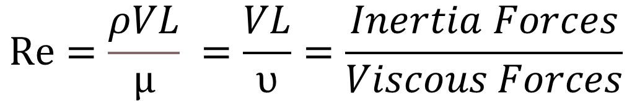
Chapter 2 – fundamental concepts
Viscosity
The Reynolds number: adimensional number that correlates the viscous behavior of all Newtonian fluids.
$$Re=\frac{ρVL}{µ} =\frac{VL}{υ}=\frac{Inertia Forces}{Viscous Forces}$$

Slide 9
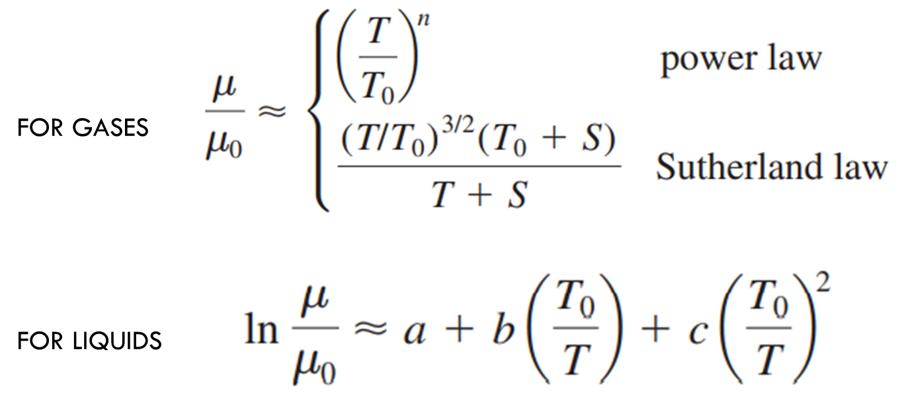
Chapter 2 – fundamental concepts
Viscosity
Variation of viscosity with temperature.

Slide 10
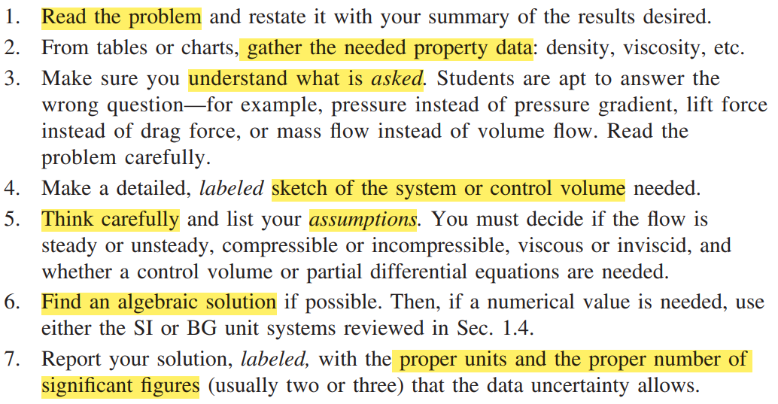
Chapter 2 – fundamental concepts
Problem Solving techniques

Slide 11
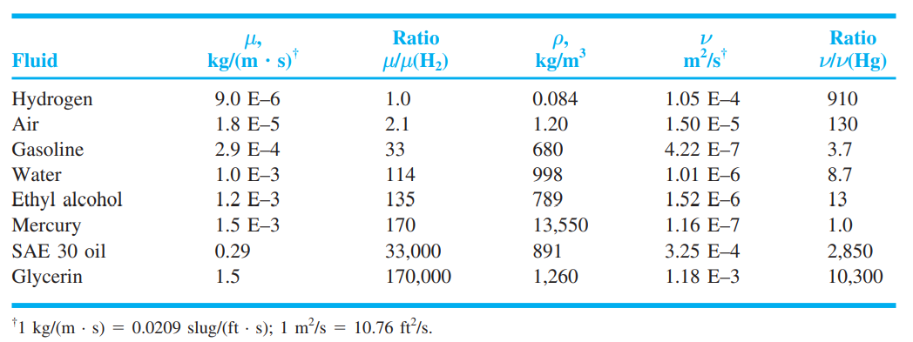
Chapter 2 – fundamental concepts
Problems

Slide 12
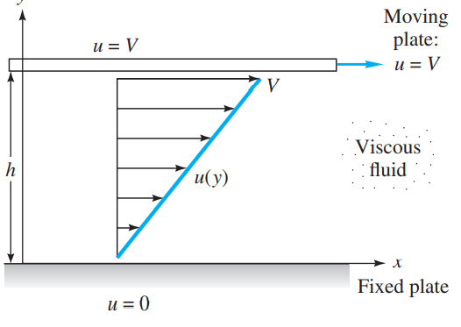
Chapter 2 – fundamental concepts
Problems

Slide 13
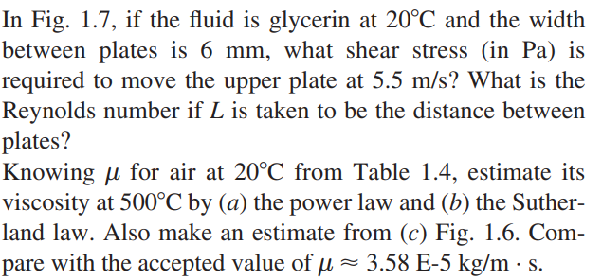
Chapter 2 – fundamental concepts
Problems

Slide 14
Chapter 2 – fundamental concepts
Problems

Slide 15
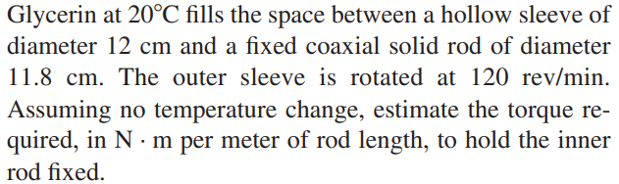
Chapter 2 – fundamental concepts
Problems

Slide 16
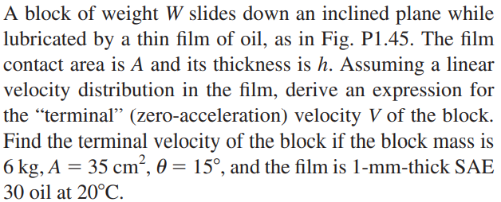
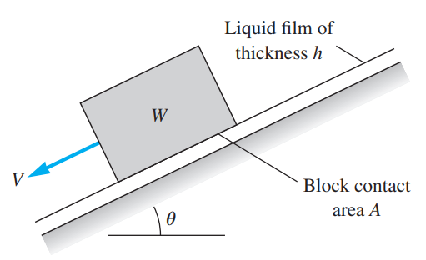
Chapter 2 – fundamental concepts
Problems

Slide 17
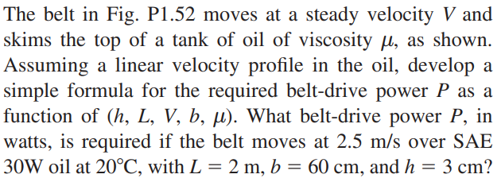
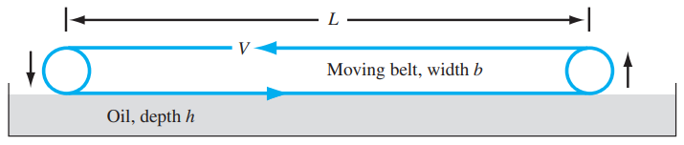
Chapter 2 – fundamental concepts
Problems

Slide 18
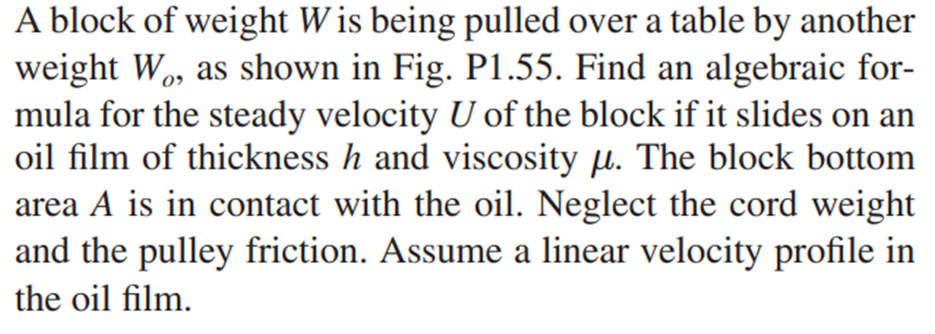
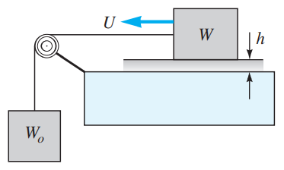
Chapter 2 – fundamental concepts
Problems

Slide 19
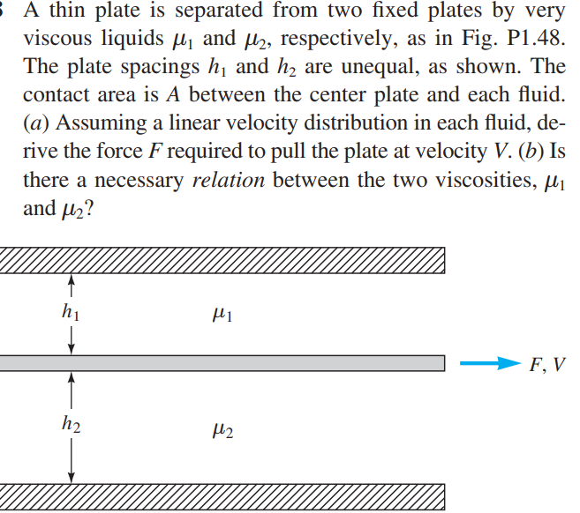
Chapter 2 – fundamental concepts
Problems

